Slide 1
ENTERTAINER ANALYSIS

Slide 2
Objective
Problem Statement
Normal life can be stressful, and people need to relax. Being entertained by others
is a wonderful way to take some time out of life. It can reduce stress and make life's
issues easier to face. The media and entertainment industry consists of film,
television, radio and print. These segments include movies, TV shows, radio shows,
news, music, newspapers, magazines, and books. Entertainment industry is a group of
sub-industries devoted to entertainment. Entertainment industry is used to describe the
mass media companies that control the distribution and manufacture of mass
media entertainment.

Slide 3
Approach
Task #1 - In a word document write the process and data added to the current dataset.
In addition, mention the theme on which you will be creating the dashboard.
Task #2 - You can add your data as per your convenience.
Task #3 – Do the data preparation part.
Task #4 – Build the dashboards
Task #5 – Build a Storyline

Slide 4
Data
1. Excel datasets
2. CSV files
3. Python Notebook
4. Power BI file(.pbix)
5. Data types of columns
6. Type of data
7. Columns

Slide 5
Architecture
Data Preparation and Cleaning
Understanding data
Discovering insights and generating reports

Slide 6
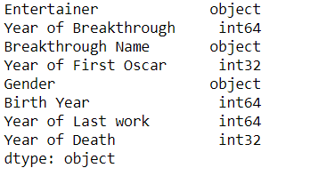
Data Validation and Data Transformation
1. Created age column from year from birth and year of death
Number of variables:
Numeric: 6
Categorical:3
Data types of the columns:

Slide 7
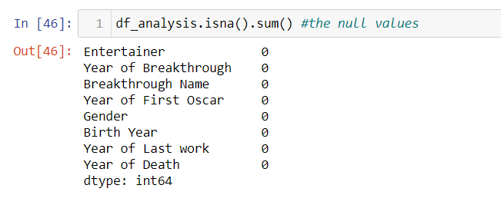
Data Validation

Slide 8
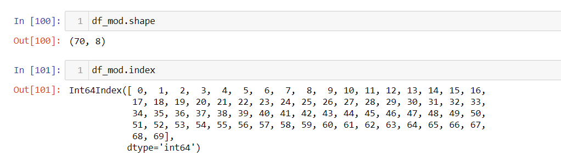
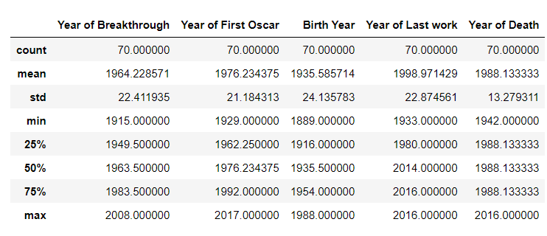
Understanding Data
The shape of the dataset is,
Description of the dataset

Slide 9
Exploratory data analysis
By using Pandas for deriving insights from the data , following insights are :
1. Unique Breakthrough names
2. Unique Entertainers
3. Unique death , birth years , Oscar year , breakthrough year, last work years
4. Entertainers with max year of last work
5. Entertainers with genders
6. Entertainers with birth years

Slide 10
Reports and visualizations
Following visuals are added to the reports and dashboards:
Extracting Entertainers name , breakthrough names by:
1. Age by Birth Year and Gender
2. Age by Death Year and Gender
3. Age by Oscar year and gender with breakthrough names
4. Age by last work year and gender with breakthrough names

Slide 11
Q and A
Q1. What is the source of the data?
https://drive.google.com/drive/folders/1sJm4vy-qfuk3CFgE_zMMPGVYFmoIg35n?usp=sharing
Q2. What is the type of data variables?
Categorical and numerical
Q3. What techniques are used to perform data preparation?
Removing columns
Deriving column
Filtering the values
Checking for null values

Slide 12
Q4. What libraries are used to perform data visualization?
Seaborn
- Plotly Express

